Slide 1
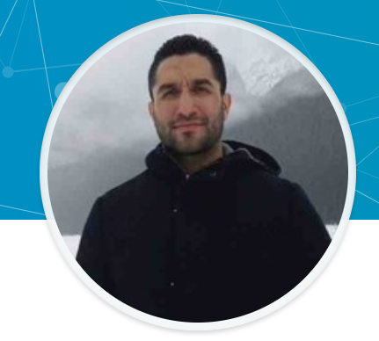
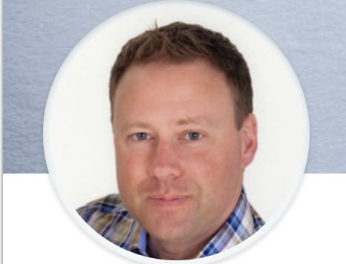
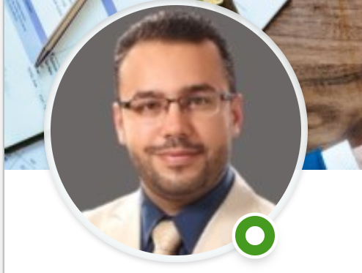

WINTECH.COM
Travel Experts Design Presentation

Slide 2
Team & Tasks
Irada
DB modification/integration, scripting dynamic registration dynamic package gallery connection (pug), Dynamic agent/agency form generation, front-end editing, project pitch ppt slides
Karim
Dynamic agent/agency form generation/Order Form submission/Contact Form submission, DB connection scripting editing/collaboration with front end editing, project pitch slides & consolidation of presentation
Anas
Front end build, html framework for index/registration/contact/gallery pages, html validation, js home page gallery, front end editing, project pitch slides
Colin
Front end support, html/css editing for registration/gallery pages, scrum admin, project pitch slides, project summary slides

Slide 3
Project Objective
This project aimed to provide a full website-DB package for Travel Experts
Main objectives
Visually engaging, encourages the client to explore the website
Utilizes skills learned to date to create a responsive website linked a MySQL database. Key components:
Dynamically populated vacation packages gallery
Order/Registration page that validates & populates client & booking date to the DB
Dynamically populated contact information page

Slide 4
Process Flow/UX
Code Elements
html
css
Java Script
Image files
Node.js
Client
Home Page
Nav links
Gallery by Region
Packages Page
Registration Page
View package info
Select package to order
Customer info entry
Returning Customer Login
Form Validation
Date Validation
Travel Experts DB
Contacts Page
Customer info form
Agency Contact
Agent Contact
Booking Form

Slide 5
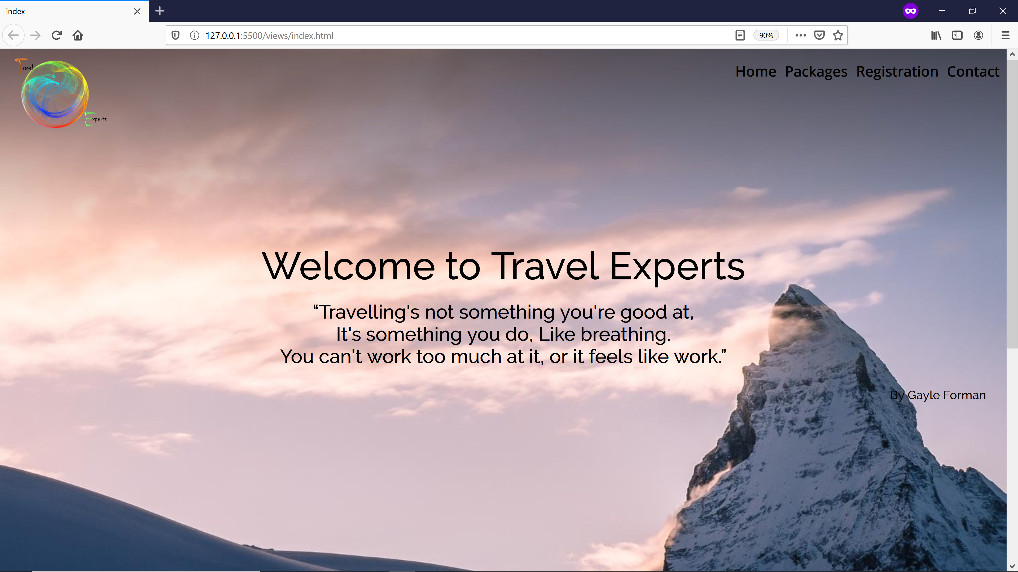
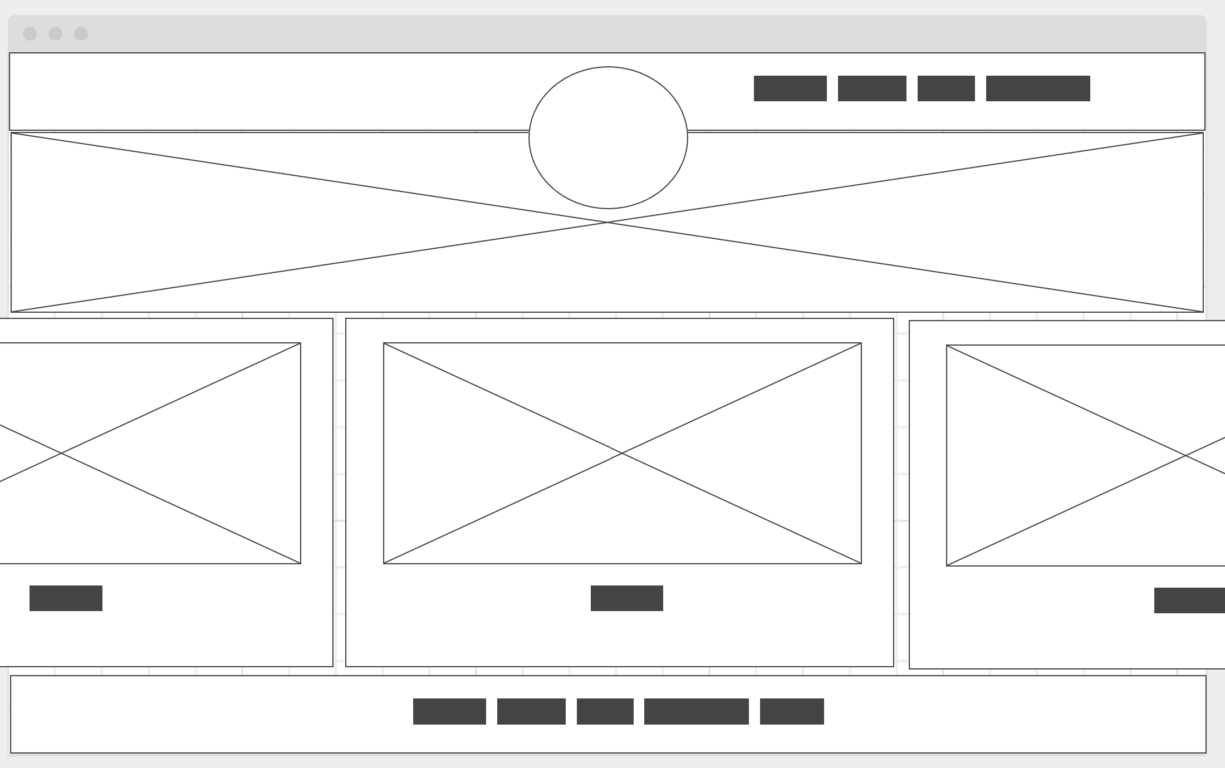
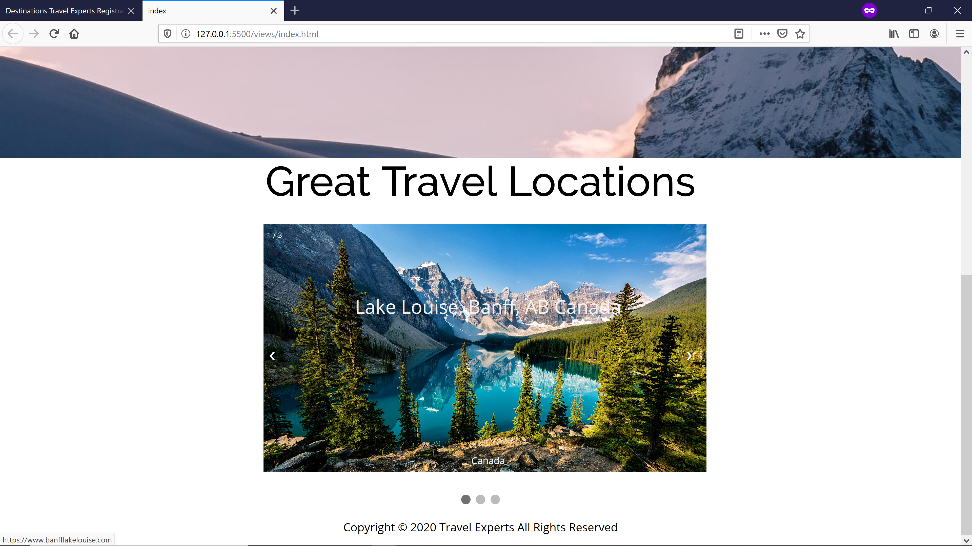
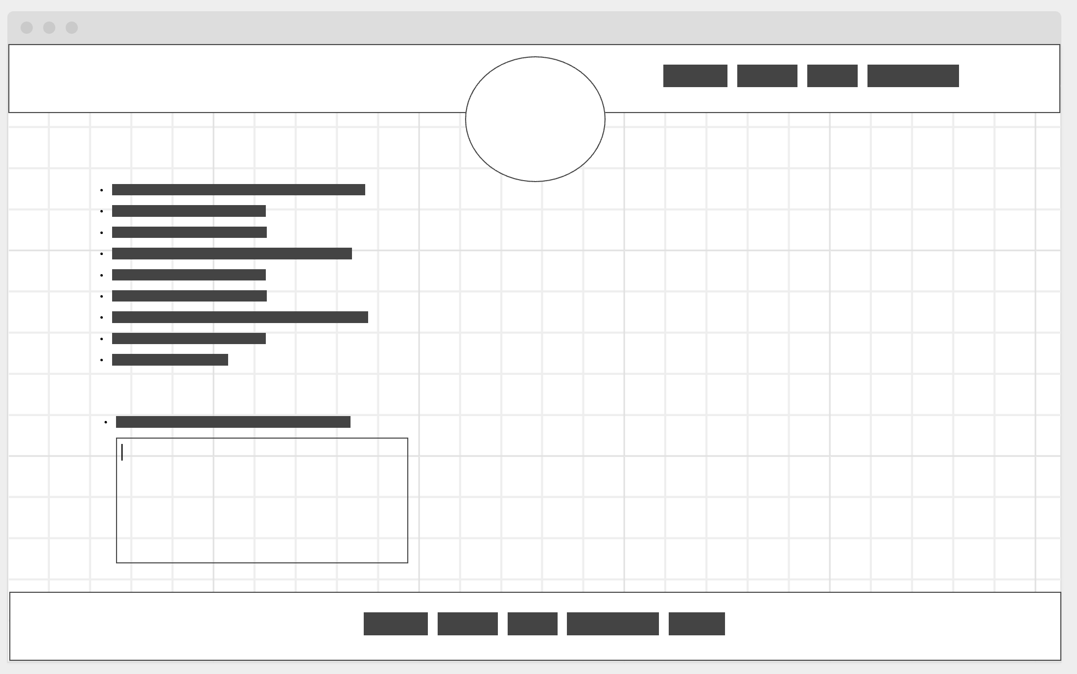
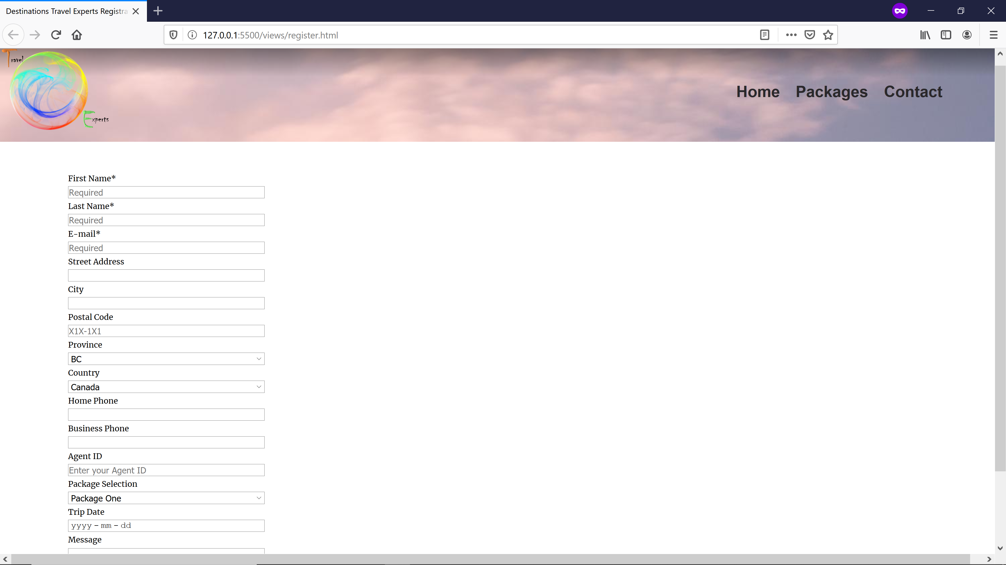
From Concept to Implementation

Slide 6
DB Connectivity
Packages Page
Registration Page
Contacts Page
html syntax: form submission & validation
Pug Template engine posts data to webpage
Pug Template engine posts data to webpage
node.js query loops package info
Node.Js Query
First pass: table join between Agent & Agency
2nd past: attempting to loop data query from each table

Slide 7
Obstacles
External Factors
Change in environment: Moving to remote collaboration on the fly
Communication: Implementing new collaboration tools and methodology
Timeline: Compressing the learning curve on remote collaboration while executing the project with newly learned tools/tech
Technical Factors

